Slide 1
Request for Proposals for
Solar Photovoltaic Alternative Energy Credits
Bidder Information Session
Presented By
  The Brattle Group
  James Reitzes
  Sophie Leamon
  Evan Bennett
Presented For
  Metropolitan Edison Company
  Pennsylvania Electric Company
  Pennsylvania Power Company
January 28, 2021

Slide 2
Format of this Webinar
Bidder Information Session
In order to maintain the communication protocols established by the Commission, all participants in this bidder information session have been muted.
  Please direct any questions to pa-spaec-rfp-2021@brattle.com after the information session has ended.
  We will respond to those questions through the FAQ process within a few days.
The audio for today’s presentation will be transmitted through the Zoom webinar. If you cannot hear the presenters speaking as you are reading this slide, please do the following:
  Confirm that your computer speakers are turned on.
  If you have any technical difficulties, please reach out to Mark Salib at mark.salib@brattle.com

Slide 3
The information contained in this presentation material is intended to provide generally descriptive and summary information. Any conflict between the information contained in this material, or conveyed orally during the bidder information session, and the information provided as part of the Company’s application in Pennsylvania Public Utility Commission (“Commission”) Docket Nos. P-2017-2637855, P-2017-2637857, and P-2017-2637858 is unintentional and the docketed material controls. Certain information contained herein may be subject to change as the Request for Proposals process continues.
Disclaimer

Slide 4
Solar Photovoltaic Alternative Energy Credits (“SPAECs”) Request for Proposals (“RFP”) Process
Bidder Information Session
  Procurement Overview
  Product to Be Procured
  Bidder Qualification and Bid Submission
  Bid Evaluation
  Post-Bidding Process
  Purchase and Sale Agreement
  Credit Provisions
  Website Format
  Conclusion

Slide 5
Procurement Process
Procurement Overview
  The RFP process is a “sealed bid,” pay-as-bid procurement.
  The product being procured are tranches of SPAECs, where a tranche is a commitment to supply 500 SPAECs annually for 2 years.
      A SPAEC is the tradable certificate that represents one MWh of electricity generated from a qualifying solar photovoltaic resource.
  In total, 274 tranches are being procured, which represents a total purchase of 137,000 SPAECs per Reporting Year for all Companies.
  The delivery period is June 1, 2021 to May 31, 2023 (Reporting Years 2022 and 2023).
  The Brattle Group is the Independent Evaluator (“IE”) for the RFP process.

Slide 6
Timetable for Procurement
Procurement Overview
Event | Date
Part 1 Date (Bidders submit Part 1 Proposals) | February 9, 2021
Bidders are notified of qualification status for submission of Part 2 Proposals | February 17, 2021
Part 2 Date (Bidders submit Part 2 Proposals including Bid and Pre-Bid Security) | March 3, 2021
Independent Evaluator submits report to Commission | March 5, 2021
Commission makes decision on results of RFP | March 10, 2021
Winning Bidders execute the SPAEC Purchase and Sale Agreement | March 15, 2021

Slide 7
Two-Part Process: Bidder Qualification and Bidding
Procurement Overview
  Bidders in the RFP process undertake a two-part application process that includes:
      Submission of qualifying application;
      Submission of bids, along with pre-bid security (in the form of cash or a letter of credit).

Slide 8
Bidding Process
Procurement Overview
  Bids state:
      Number of tranches offered;
      $XX.xx per SPAEC;
      Whether bid is “all-or-nothing” (only applies up to 4 tranches).
  All-or-nothing bids mean that either all of the offered tranches have to be accepted, or none are accepted.
    The all-or-nothing designation can apply to no more than 4 tranches. If an all-or-nothing bid is submitted for more than 4 tranches, any number of tranches from 4 up to the number of tranches offered may be accepted.
  Tranche Cap: 205 tranches maximum per bidder.

Slide 9
Winning Bids and Post-Bidding Process
Procurement Overview
  Although this is a joint procurement by Met-Ed, Penelec, and Penn Power, the winning bidders will be assigned to individual Companies for purposes of signing SPAEC PSAs and making SPAEC deliveries.
  Least-cost bidder(s) are the winning bidders, subject to constraints imposed by “all-or-nothing” bids.
  IE has 2 business days from the bidding date to submit report to the Pennsylvania Public Utility Commission (“Commission”) containing the results of the RFP Process.
  The Commission has 3 business days after receiving the IE’s report to decide on the results of the RFP.
  If approved, winning bidders have 3 business days from the Commission’s decision to execute the SPAEC Purchase and Sale Agreement (“SPAECPSA”).

Slide 10
Product to Be Procured
Bidder Information Session

Slide 11
SPAEC Tranches and Quantity
Product to be Procured
  A “tranche” of SPAECs, where one tranche is an obligation to supply 500 SPAECs annually for two years.
                The obligation is to supply 500 SPAECs per tranche in each of Reporting Year 2022 (June 1, 2021 to May 31, 2022) and Reporting Year 2023 (June 1, 2022 to May 31, 2023).
  Total procurement target is 137,000 SPAECs per Reporting Year for all Companies, broken into 274 tranches.
  No supplier can bid for more than 205 tranches.
  No energy or capacity is being procured. This is a SPAEC only procurement.

Slide 12
Supplier Obligations
Product to be Procured
  Suppliers will be expected to transfer their SPAECs quarterly to the respective Company throughout the life of their contracts.
    SPAECs must be generated in the applicable delivery year.
    Combined transfers in each Reporting Year must equal the number of tranches to which the supplier is obligated, multiplied by 500 SPAECs per tranche.
    The SPAEC Purchase and Sale Agreement (“SPAECPSA”) requires quarterly deliveries of SPAECs (125 per quarter per tranche awarded).

Slide 13
Eligible SPAECs
Product to be Procured
  The Company will only accept SPAECs that comply with the Pennsylvania Alternative Energy Portfolio Standards Act and are generated through PJM Environmental Information Services Inc.’s (“PJM-EIS”) Generation Attributes Tracking System (“GATS”).
  SPAECs must be from a solar PV resource sourced in PA
  The solar PV resource must be grid connected (includes "net-metered" systems)
  SPAECs do not have to be from a specific facility (i.e., this is not a unit-contingent obligation).

Slide 14
Bidder Qualification and Bid Submission
Bidder Information Session

Slide 15
Bidder Qualification and Bid Submission
Bidder qualification and Bid Submission
  Part 1 Application – Bidder Qualification (due Feb. 9)
    General qualifications;
    Financial and other qualifications to become a bidder:
      If seeking an unsecured line of credit, which requires a rating by two of S&P, Moody’s, or Fitch, certain financial information is required (e.g., 10-K, 10-Q, 8-K filings).
      If there are changes to the standard forms of the Pre-Bid Letter of Credit, Bidder must submit proposed changes for approval along with Part 1 Application.
  Part 2 Application – Bid Submission (due Mar. 3)
    Provision of pre-bid security;
      Mandatory for all bidders, in form of cash or letter of credit.
    Submission of bids.

Slide 16
Bidder Qualification
Bidder qualification and Bid Submission
  Prospective bidders must:
    Provide contact information;
    Designate an officer of the bidder to sign application;
    Designate a representative and credit representative;
    Provide credit information;
    Provide any proposed modifications to standard Pre-Bid Letter of Credit;
    Make certifications regarding independence, ability to perform, acceptance of terms of PSA, acceptance of RFP rules, and other conditions.

Slide 17
Bid Submission
Bidder qualification and Bid Submission
  Bidders must:
    Specify number of tranches that they are interested in;
    Specify the bid price: $XX.xx per SPAEC for all tranches offered;
    Specify whether the bid is “all or nothing” (for up to the first 4 tranches);
    Provide pre-bid security in the form of a Letter of Credit or cash equal to:
      (number of tranches x 500) x (2 x bid price) x 10%;
    Make various certifications regarding independence, confidentiality, compliance, etc.

Slide 18
Bidder Evaluation
Bidder Information Session

Slide 19
Potential Impact of All-or-Nothing Bids
Bidder Evaluation
Illustrative “All-or-Nothing” Bid Scenarios
Note: The “all-or-nothing” designation applies to 4 tranches or less. If the “all-or-nothing” designation is used with a bid that specifies a maximum number of tranches in excess of 4 tranches, then that bid may be accepted for any number of tranches from 4 up to the maximum number. For example, an “all-or-nothing” bid for 6 tranches may be accepted for 4, 5, or 6 tranches.

Slide 20
Post-Bidding Process
Bidder Information Session

Slide 21
Post-Bidding Schedule
Post-Bidding Process
March 5, 2021: IE reports results to the Commission within two business days.
March 10, 2021: Commission makes decision.
March 15, 2021: If IE reported results are approved by the Commission, winning bidders must execute SPAECPSAs.

Slide 22
Purchase and Sale Agreement
Bidder Information Session

Slide 23
Supplier Delivery Obligations
Purchase and Sale Agreement
  Must open and maintain a PJM GATS account at their own expense.
  Bidders required to deliver SPAECs quarterly (125 per quarter per tranche awarded).
  Transfers to the applicable PJM GATS account must be completed no later than 45 days following the end of the quarter.

Slide 24
Payment Terms and Default
Purchase and Sale Agreement
Payment terms
  Quarterly payment (within 30 days of invoice, 60 days of delivery)
Supplier Payment Obligations in Event of Default
  Supplier pays liquidated damages equal to:
    = [(SPAEC replacement price – SPAEC purchase price) x quantity of SPAECs not delivered]
    + fees
    + any related alternative compliance payments made by the Company.

Slide 25
Credit Provisions
Bidder Information Session

Slide 26
Key Elements
Credit Provisions
  Security posted during the term of the PSA will depend upon a creditworthiness evaluation.
    Unsecured credit may be granted based on the Bidder’s or its Guarantor’s Tangible Net Worth and credit rating (see Article 5.1 of the PSA).
    Exposure beyond unsecured credit (if any) must be met with cash and/or letter of credit (see Article 5.2 of the PSA).
  Credit Exposure Amount equals the following:
    (Number of Tranches x 500) x (2 x Bid Price)
    Upon request, the Companies shall reduce the Credit Exposure Amount for SPAECs delivered.

Slide 27
Creditworthiness: Three Options
Credit Provisions
  Seek an unsecured line of credit by relying on Bidder’s own financial standing.
    Part 1: submit financial information relevant to receiving an Unsecured Credit Limit (“UCL”), which requires that the Entity is rated by two of S&P, Moody’s, or Fitch.
  Seek an unsecured line of credit by relying on Guarantor’s financial standing.
    Part 1: submit financial information for the Guarantor relevant to receiving an UCL, which requires that the Guarantor is rated by two of S&P, Moody’s, or Fitch.
  Elect not to apply for an unsecured line of credit.

Slide 28
Required Information for Unsecured Line of Credit
Credit Provisions
  Financial statements (SEC Form 10-K, 10-Q, 8-K, audited balance sheet, income, and cash flow statements);
  A statement of rulings or judgements relating to financial status that have had a material impact on financial status;
  A debt rating from at least two of the following rating agencies: S&P, Fitch, or Moody’s (with supporting documentation);
  Contact information of a credit representative to answer questions on the documentation provided.

Slide 29
Pre-Bid Security (Submitted with Bid)
Credit Provisions
  All Bidders must submit Pre-Bid security along with their bid in the form of cash or Letter of Credit.
    The standard form of the Pre-Bid Letter of Credit is on the RFP website.
    If you wish to make any modifications to the standard form of the Pre-Bid Letter of Credit, you must submit these proposed changes along with your Part 1 Application.
  Applicants who submit with their Part 2 Application a Pre-Bid Letter of Credit with unapproved modifications run the risk of their bid not being accepted.

Slide 30
Website Format
Bidder Information Session

Slide 31
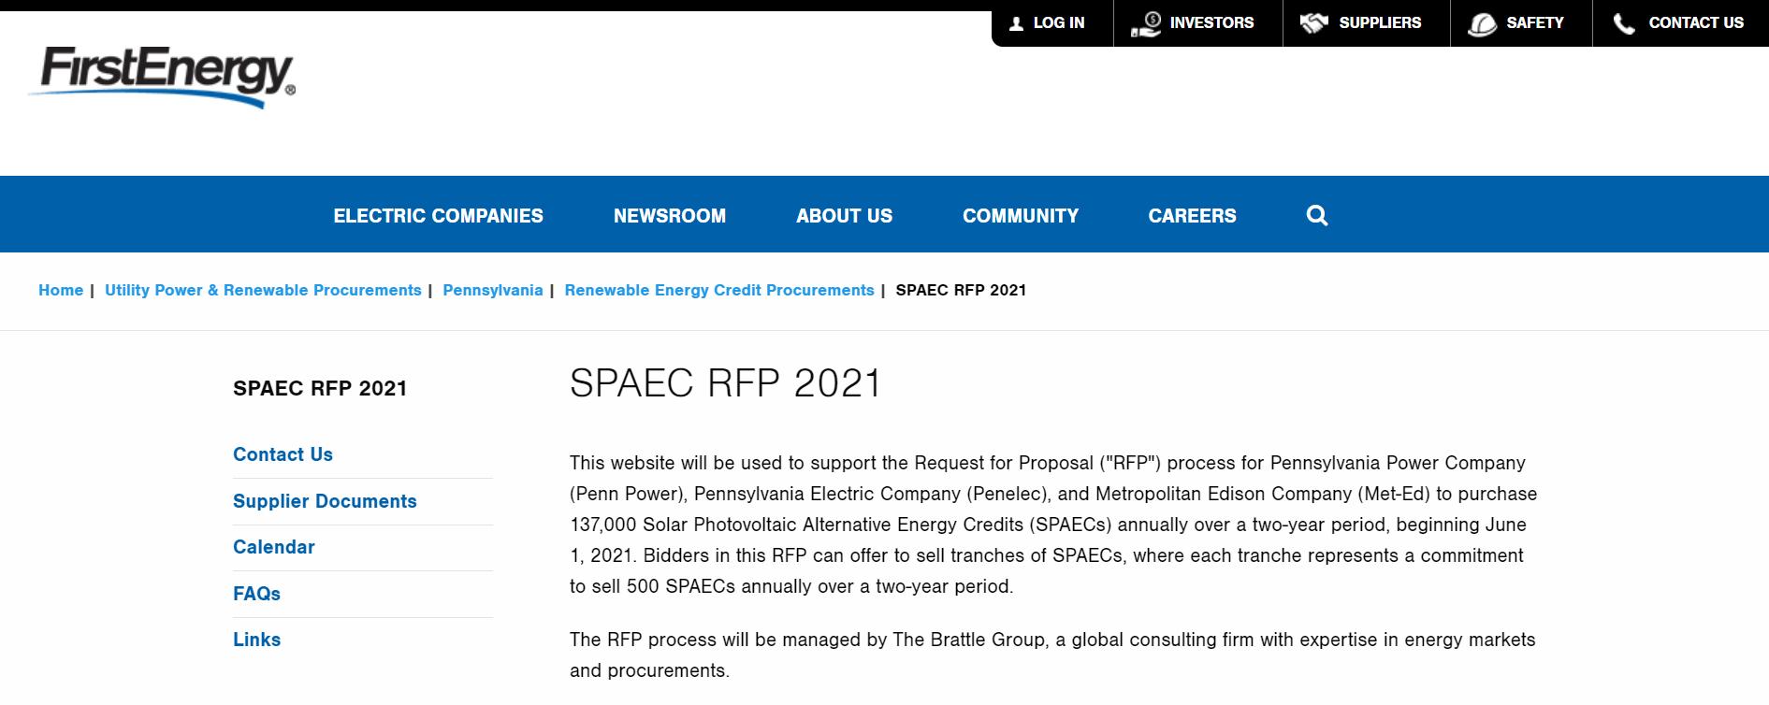
Home Page
Website Format
  www.firstenergycorp.com/PA2021SPAECRFP

Slide 32
Website Organization
Website Format
  Announcements: Periodic announcements about the progress of the RFP.
  Contact Us: Instructs potential bidders to email The Brattle Group with questions.
  Supplier Documents: Links to all of the documents necessary to participate in the RFP, including the Rules, Part 1 and 2 Forms, Purchase and Sale Agreement, and credit documents.
  Calendar: Lists important events and dates for the RFP.
  FAQs: Contains answers to questions we have received throughout the RFP. The FAQs are updated frequently, so it is often worth checking here before asking a question.
  Links: Provides access to other potentially helpful information.

Slide 33
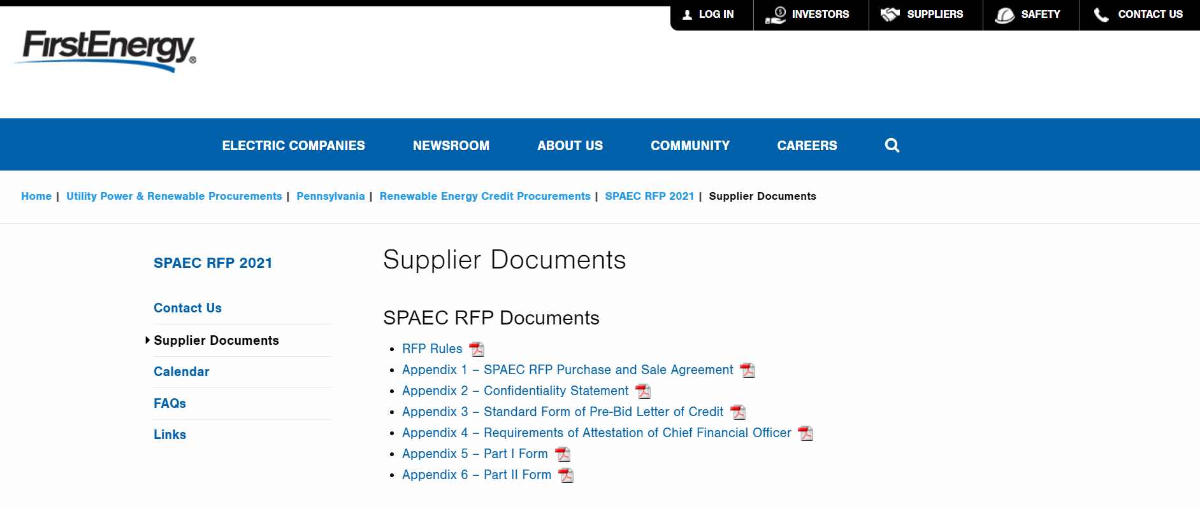
Supplier Documents Page Example
Website Format

Slide 34
Q&A’s
Responses to Questions Will Be Posted to the Procurement Website
Please Direct All Questions To:
pa-spaec-rfp-2021@brattle.com

