Slide 1
PA Supplier Workshop
Net Metering

Slide 2
Agenda
Overview of Smart Meter
Overview of Net Metering
Changes
Customer Invoicing (Bill Print presentation changes)
Settlements
Banking
EDI Changes (Differences between Delivered and Received)
867s (MU, IU, HU)
810 (Rate Ready)
PA Supplier Workshop
September 10, 2019

Slide 3
Change Controls
The changes we will discuss are being implemented as a result of PA EDEWG Change Controls 150 and 151
Change Control 150 was approved on April 11th, 2019
Change Control 151 was approved on May 9th, 2019
These change controls are part of accommodating Rider D to increase solar usage by PA customers.
Rider D encourages customers to use solar and other alternative sources by receiving a larger discount than what they would pay if they didn’t have it.
PA Supplier Workshop
September 10, 2019

Slide 4
PA Smart Meter Implementation Timeline
P
P
P
Completed
Filed Plan PLUS Approved
Automated Billing In Penn Power
Interval Data available; Automated Billing Available to all OpCos
P
Pilot Voluntary Remote Connect / Disconnect (Penn Power)
Benefits Realization Begins
P
P
Initiate Hourly Pricing Billing
Voluntary Remote Connect / Disconnect (All OpCos)
P
P
Enable Net Metering Billing
Meters
New Business
50K (PP)
120K (PP)
500K
500K
500K
300K
~1.5%
Remaining
Network
 | Installed
Connected Grid Routers | 116
Range Extenders | 502
 | Installed | Remaining
Connected Grid Routers | 1,617 | 0
Range Extenders | 7,131 | 376
Data as of 8/23/19
Smart Meter
Operations
Center
(SMOC)
SMOC
Set Up
SMOC Monitoring and Reporting
Year
2013
2014
2015
2016
2017
2018
2019
2020+
Solution Validation Phase
Penn Power Only
Full Scale Deployment
Original plan as of June 2014
PA Supplier Workshop
September 10, 2019
Notes:
4
4

Slide 5
About Net Metering
Net Metering is a rate tariff rider available to customers that install renewable generators such as solar, wind, or hydro power. These customers operate the generator in conjunction with usage from the electric company’s electrical system. A meter with bi-directional functionality, such as a smart meter, is required.
Bi-directional meters measure:
Delivered – Electricity supplied by an electric utility to the customer
Received – Electricity produced by a customer-generator and supplied to the electric utility for purchase by either the utility or the customer’s supplier
PA Supplier Workshop
September 10, 2019

Slide 6
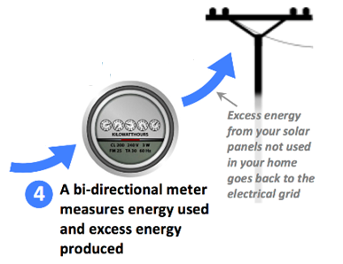
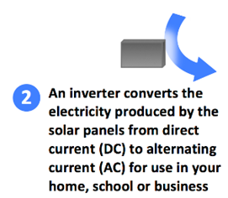
Net Metering | What is it?
Per PA Act 213 of 2004 – Alternative Energy Portfolio Standards Act…
Net Metering is measuring the difference between electricity supplied by an electric utility, and electricity generated by a customer-generator
…when any portion of the electricity generated by the alternative energy generating system is used to offset part or all of the customer-generator’s requirements for electricity.
Buy from Grid = Utility ‘Delivered’ kWh
Sell to the Grid = Utility ‘Received’ kWh
Net = ‘Delivered’ minus ‘Received’
PA Supplier Workshop
September 10, 2019

Slide 7
Net Metering | PA Utility Tariff Perspective, Rider D – Net Metering Rider
Utility is required to offer Net Metering Rider per statute
PURPOSE
Applicable to Customers with installed renewable customer-owned generation
APPLICABILITY
Rider available to Residential as well as Commercial & Industrial Rates
Generation capacity of not greater than 50 kilowatts for residential service or not greater than 3,000 kilowatts at other customer service locations
Customer facility shall be equipped with a single bi-directional meter that can measure and record the flow of electricity in both directions
BILLING
PROVISIONS
The customer-generator will receive a credit for each kilowatt-hour received up to the total amount of electricity delivered to the Customer during the billing period
If the Company delivers more kWh than received from the customer-generator facility during the billing period, the resultant bill for a full service customer is as if the billing determinant was based on the NET kWh consumption, the generation value of received kWh being ‘full retail value’
PA Supplier Workshop
September 10, 2019

Slide 8
Net Metering Example 1
Solar Power Example
With Sunshine over an hour…
5.00kWh
2.50kWh
2.50kWh
Example:
Customer usage is 2.50 kWh while solar generation is 5.00 kWh.
Utility ‘Delivered’ = EDI 867 REF*6W*1 will portray 0 kWh
Utility ‘Received’ = EDI 867 REF*6W*2 will portray 2.50 kWh
Excess = 2.50 kWh
PA Supplier Workshop
September 10, 2019

Slide 9
Net Metering Example 2
Solar Power Example
With limited Sunshine over an hour…
1.00kWh
1.50kWh
2.50kWh
Example:
Customer usage is 2.50kWh while solar generation is 1.00kWh.
Utility ‘Delivered’ = EDI 867 REF*6W*1 will portray 1.50 kWh
Utility ‘Received’ = EDI 867 REF*6W*2 will portray 0.00 kWh
Excess = 0.00 kWh
PA Supplier Workshop
September 10, 2019

Slide 10
Changes in Net Metered Invoicing
Old Method
New Method
Net of delivered and received kWh used for billing
Bill based on delivered kWh
Credit based on received kWh up to the delivered kWh value
Example
Delivered = 350 kWh
Received = 200 kWh
Net Delivered = 150 kWh
*150 kWh is used for ALL billing determinants
Example
Delivered = 350 kWh
Received = 200 kWh
*Customer billed for 350 kWh (delivered) and receives a credit on 200 kWh (received)
For full service customers, the purchase power credit for the 200kWh is such that the resultant total bill is the same as if net kWh were used as the billing determinant
For shopping customers, rate ready supply charges are now based on delivered kwh versus net; any generation credit for the received kwh are the responsibility of the supplier; utility provides credit on distribution
PA Supplier Workshop
September 10, 2019

Slide 11
Net Metering | Changes in Settlement
Smart Meter Interval Metering vs Monthly Metering
Smart meters enable all accounts to be hourly metered accounts and settlement with PJM becomes more accurate of physical flow for customers on Rider D
Settlements provides actual hourly data to PJM for reconciliation of scheduled vs actual hourly energy consumption AND production
Previously, the NET kWh used for billing determinant in retail billing was simply ‘profiled’ to an hourly schedule using applicable class profiles
With this change, actual hourly usage for ‘delivered’ kWh will be reported as consumption, while actual hourly generation ‘received’ will be reported in a second schedule as production
For a full service customer, this production is reported against the POLR schedule
For a shopping customer, this production is reported for the load serving entity
PA Supplier Workshop
September 10, 2019

Slide 12
Net Metering | Banking Mechanism
The customer-generator will receive a credit for each kilowatt-hour received UP TO the total amount of electricity delivered to the Customer during the service period
For service periods where received kWh exceeds delivered kWh, the excess will be banked for use in the next billing cycle
If a non-hourly default customer, the valuation of this banked kWh in the next billing cycle is full retail value as billed in that next cycle
If an hourly priced default customer, the excess if valued at the hourly prices in which is was produced and a dollar value is assigned upon ‘deposit’ and used for credit in the next billing cycle
The bank is trued up annually or at any time status changes in shopping, at which time any balance is a true up credit and the bank value is reset to zero
PA Supplier Workshop
September 10, 2019

Slide 13
Changes in Net Metered Invoicing
KWH Out is now Kilowatt Hours Delivered
KWH Metered is now Kilowatt Hours Received
PA Supplier Workshop
September 10, 2019

Slide 14
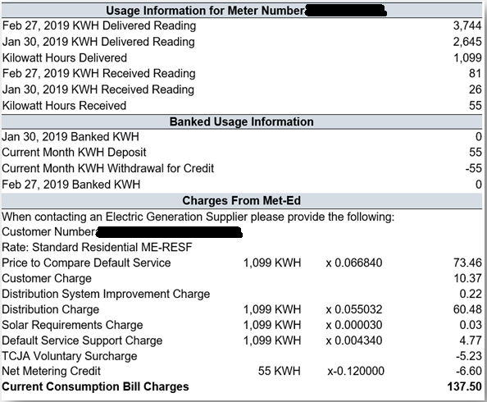
Net Metering Credits
Credit Calculation
The Net Metering Credit is the excess kilowatt hours received up to the delivered kWh value
Banked Usage Info
Banked usage is now shown on the invoice
Delivered usage is now used as the billing determinant, while received usage has a separate line item for the credit.
Recall, for shopping customers, the Net Metering Credit is a discount on the distribution portion only and does not include any crediting for generation.
PA Supplier Workshop
September 10, 2019

Slide 15
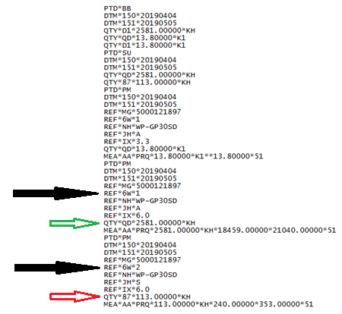
Net Meter 867
Customer generates LESS than delivered consumption
PA Supplier Workshop
September 10, 2019

Slide 16
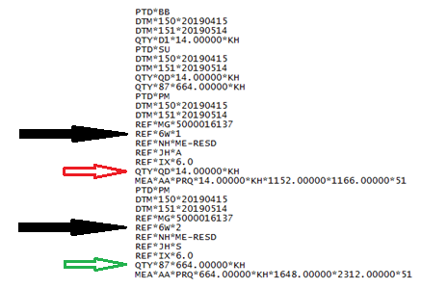
Net Meter 867
Customer generates MORE than delivered consumption
The supplier will receive the credit for their customer's excess generation via their PJM bill and is responsible for providing that credit back to their customer.
PA Supplier Workshop
September 10, 2019

Slide 17
Net Meter 810 (Rate Ready)
Rate Ready 810 charges will be calculated based on:
Delivered kWh usage
Rate Ready 810 will not be calculated based on:
Net kWh usage
The EDI SAC*C line will show delivered kWh:
PA Supplier Workshop
September 10, 2019

Slide 18
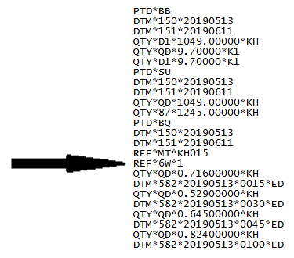
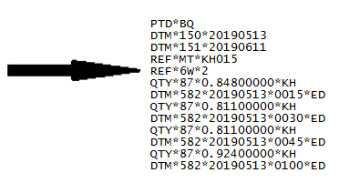
Net Meter 867 IU
Delivered
Received
PA Supplier Workshop
September 10, 2019

Slide 19
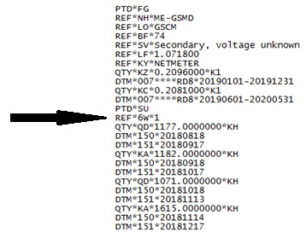
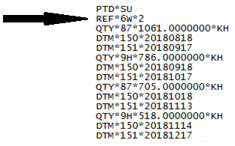
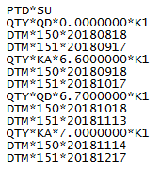
Net Meter 867 HU
Delivered
Received
Other units of measure will NOT be affected, such as K1 or K2
PA Supplier Workshop
September 10, 2019

Slide 20
Process
867 MU
Net metered customer that bills after 8/16/19
867 IU
Any request sent after 8/16/19:
867 HIU
Changes will not take place until the customer has 12 months of bill certified interval data
867 HU
Changes will take place on any bill with a service period start date commencing 8/16/19
PTD*SU loop will have the new changes with the REF*6W lines in the PTD*PM loops to report Delivered & Received usage
PTD*BB loop will report the Delivered usage instead of net usage as approved in Change Control 150
(First cycle to be billed with a service period start commencing 8/16/19 is expected on or after 9/18/19)
PTD*SU loops will have the new changes for kWh with the REF*6W lines to report the delivered and received usage instead of net usage as approved in Change Control 151
Changes will not take place for a customer that moves into a bill certified premise that only has interval meter data available
Net metered customer that bills service period start date prior to 8/16/19
the utility will continue to bill on “net” for any customer that has a bill period with a service period start date prior to 8/16/19
Rate Ready will bill on net until the first cycle with a service period start date commencing 8/16/19
Bill Ready / Dual Bill will have the 867 changes applied and the EGS needs to bill as appropriate
PA Supplier Workshop
September 10, 2019

Slide 21
Questions
?
?
?
?
?
PA Supplier Workshop
September 10, 2019

Slide 22
Questions – with Responses
Can FirstEnergy send sample files for EDI 867?
Yes, please contact Ernie Mathie to request sample files.
Can EDI sample files be requested via the supplier support e-mail?
You may use the contact us form on our Supplier Services website.
Will EDI samples be in the format of production or testing?
Samples will be a text file. All the intervals will be in the same transaction when the change occurs.
Regarding EDI 867 MU on slide 20, have these changes already occurred?
The EDI 867 MU changes are seen now for customers who billed after 08/16/2019. The slide also details other changes per EDI 867 type.
Will the presentation be available?
Yes, we will send the presentation as soon as we can, with an appendix of Q&A. We will also post to website.
Will the minimum individual customer capacity be zero kwh?
Yes.

