Slide 1
PA Supplier Workshop

Slide 2
Agenda
Supplier Workshop Objective
Customer Referral Program Overview
Customer Referral Program Script
Recent Issues
  Incorrect Rate Ready enrollments
Questions

Slide 3
Supplier Workshop Objective
Customer Referral Program Discussion
  The Companies agreed to reconvene their supplier workshops so that Customer Referral Program Suppliers and the Companies are provided a collaborative forum to discuss operational enhancements that can be implemented by the Companies and the EGS participants to improve administration of the program.

Slide 4
Customer Referral Program and Scripting
The program will continue through May 31, 2023.
Commission directed OCMO to convene a group of interested stakeholders for the purpose of collaboratively addressing the scripting and training materials associated with the program:
  (a) to ensure that such scripting and training materials will provide sufficient consumer education/protections and disclaimers to customers that are not misleading, and
  (b) to determine the impacts that such scripting and training materials may have on a customer enrollment in the program as well as any other competitive concerns.

Slide 5
Customer Referral Program Overview
The program is designed to encourage shopping in the Companies’ Pennsylvania service territories.
The program is offered to Met-Ed, Penelec, Penn Power, and West Penn Power non-shopping residential and small commercial customers.
The program offers a 12-month fixed price that is set at 7% below the EDC’s current Price-To-Compare.

Slide 6
Customer Referral Program - Customer Process
When a customer calls into the Companies’ Contact Center for a move-in, high billing question, or a question on energy choice, and are eligible, they will be offered the Customer Referral Program.
If the customer decides to participate in this program, they will be transferred to our third-party vendor to select a supplier from one of the participating suppliers.
If the customer doesn’t have a specific supplier in mind, a supplier will randomly be selected for the customer through a round robin selection.

Slide 7
Customer Referral Program - Supplier Process
A quarterly email is sent to all licensed suppliers in the Companies’ territories notifying them to express their intent to participate in the Customer Referral Program.
  The supplier will be provided a deadline for their intent to participate.
The suppliers who wish to participate will send by email their contracts including Appendix C (Intent to Participate) stating what operating companies they wish to participate in. The supplier may participate in Residential and Small Commercial, separately or together.
  For first-time participants, this is required no less than 60 days prior to the quarter.

Slide 8
Customer Referral Program - Supplier Process
The Price to Compare will be released during the months of January, April, July, and October, depending on the quarter. At this time an email will be sent to participating suppliers communicating the PTC, as well as an intent to withdraw date.
  The participating suppliers will use the PTC to determine if they want to participate in the Customer Referral Program for the quarter.

Slide 9
Supplier Requirements
Must be a registered EGS for the territory in which they would like to participate (ME, PN, PP and/or WP).
  Must complete supplier registration.
  Upon delivery of registration application and review of documents, the supplier will be contacted to complete EDI testing for Rate Ready billing.
Assume load responsibility.
Accept and enroll all referred customers in the Customer Referral Program.
Utilize a Rate Ready bill method only.
  Supplier must serve the customer on the Customer Referral fixed rate for 12 consecutive billing periods.

Slide 10
Supplier Requirements
The supplier must complete and sign the contract and, for first-time participants, return it at least 60 days prior to the start of the quarter if they wish to participate.
  This contract does not need to be completed each time as long as nothing changes from previous quarter participation.
If the supplier totally withdraws for any quarter, the supplier will need to complete a new contract to participate.
Participating suppliers will be invoiced monthly. Any accepted enrollment sent with the “Customer Referral” rate will be charged $30.00 per enrollment. Rejected enrollments are not charged.
The supplier is provided a timeline on the Companies’ website which provides dates for intent to participate and withdraw.

Slide 11
Customer Referral Program Design
Customer Referral Suppliers begin participation in the Program effective on the following dates each year: March 1, June 1, September 1, or December 1.
A new Customer Referral Supplier must provide the initial notice of their intent to participate in the Customer Referral Program at least sixty days prior to the desired effective date.
A Customer Referral Supplier that has previously participated in the Company’s Customer Referral Program must provide notice of their intent to participate at least thirty days prior to the desired effective date.
  Note – If you are not rate ready tested for a Company in which you would like to participate, you must always follow the 60-day timeline.

Slide 12
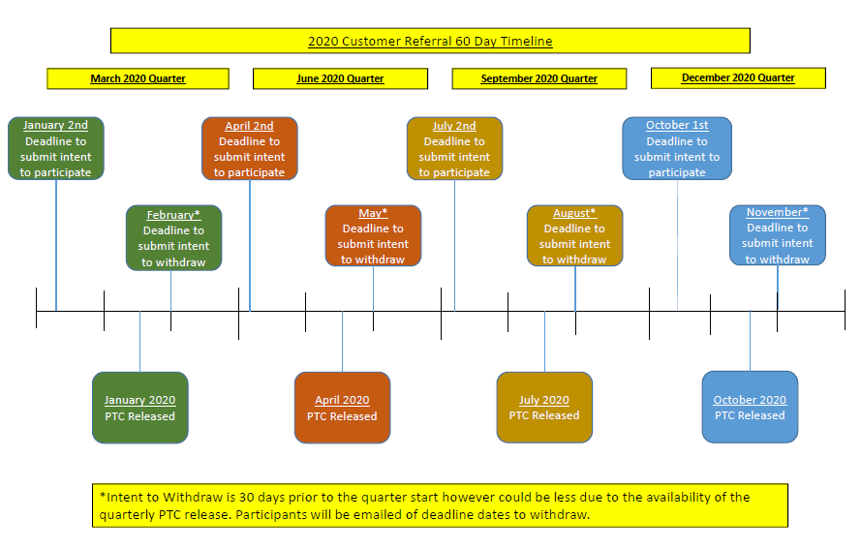
2020 Timeline - 60 Day

Slide 13
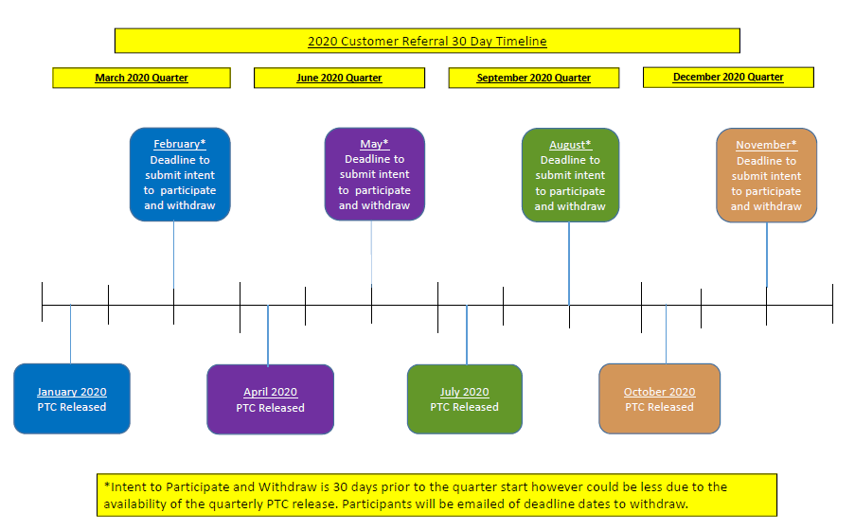
2020 Timeline - 30 Day

Slide 14
Current CRP Contact Center Script
On the questions tab:
  In Pennsylvania, you can choose the company that provides your electricity without impacting the quality of service. Would you like to speak to a representative who can offer you a potential savings opportunity by enrolling with an electric generation supplier?
Summary tab scripting depends on answer selected:
  If Yes: Are you satisfied with what I have done for you today? I have completed your order. With your permission, I will transfer you and your order information to our Connections program. They will provide you with a confirmation number, offer you potential rate savings through our Electric Choice Program, and help you to set up other services if needed.
  If No: Are you satisfied with what I have done for you today? I have completed your order. With your permission, I will transfer you and your order information to our Connections program that will provide you with a confirmation number and also help you to set up other services if needed.

Slide 15
Current CRP Vendor Script
[CUSTOMER NAME], there are many registered electric suppliers doing business in the state of Pennsylvania and you have the option of choosing any of them. In an effort to encourage choice, the State Utility Commission has made the Standard Offer program available to you.
The program offer is a 7 % discount off the current Price to Compare that you are paying with [EDC NAME] as your default service supplier. There are no fees for selecting an alternate supplier today or any penalties for changing suppliers before the 12 months are up.
The current Price to Compare rate for [EDC NAME] is [X.XX] cents per kilowatt-hour. The rate for this Standard offer is X.XXX cents per kilowatt-hour. The Standard Offer rate may be higher or lower than the price to compare and the percentage savings you will experience compared to [EDC NAME] supplier generation will vary as the price to compare changes. The price to compare changes quarterly in March, June, September and December, however your Standard Offer rate will remain fixed the same for 12 billing cycles and is the same no matter which participating supplier you select.
You can cancel this contract anytime without penalty and select another supplier or return to default service with [EDC NAME] for service at the Price To Compare. I can enroll you with an approved supplier of your choice from our list or I can select one for you. Do you have questions? Do you agree to be enrolled with a supplier for this program?

Slide 16
Recent Issues: Incorrect Rate Ready enrollments
Issue: Supplier sends incorrect CRP enrollment rate
  Enrollment rate is provided quarterly via Appendix A
  Enrollment rate is based on the FTP file date that is sent from our third-party vendor
  Enrollment is NOT based on the date the supplier sends the enrollment to the utility
Result: Customer is charged incorrect CRP rate
Impacts:
  Customer satisfaction
  Manual work to correct the issue
    EDI transactions need sent
    Calculation of the refund due to the customer
    Send the customer a notification letter
    Supplier sends refund check to utility
    Utility applies the refund to the customer account
  Costs time and dollars for both supplier and utility
  Supplier at risk of being removed from the program if not corrected timely

Slide 17
Timeline Example
Customer calls the contact center
The customer enrolls in the Customer Referral Program on August 31 (June Quarter)
The customer file is sent to the Supplier’s FTP site on August 31 (June Quarter)
Supplier sends the CRP enrollment on September 1 as a June Quarter rate based on the FTP file date and not for the September Quarter rate

Slide 18
CRP Quarter Dates
CRP Quarters
March
Quarter
(1)
March 1 - May 31
June
Quarter
(2)
September
Quarter
(3)
September 1 -November 30
December
Quarter
(4)
December 1 - February 28
June 1 - August 31

Slide 19
CRP Rate Naming Convention
The CRP rate will always begin with CR-
Next is a 2-letter abbreviation for the utility (ME, PN, PP, WP)
Then Residential or Commercial customer (R or C)
Next is the Quarter number (1,2,3,4)
Finally is the last two digits of the year (20)
Example: Customer Referral customer, Penn Power, Residential customer, 4th Quarter of 2020 = CR-PPRQ420

Slide 20

Monthly CRP Rate Audit
A monthly CRP rate audit is performed to determine if customers are on the correct CRP rate for the quarter.
The Supplier’s CRP enrollment and CRP rate is compared with the CRP rate for that Quarter.
Below is a sample of how a mismatch between CRP rates would look.

Slide 21
Questions
Question: The timing of intent to participate per when the Price-To-Compare information is released is such that we have to submit our intent to participate with when the PTC is released. There's a lot of paperwork back and forth if we don't know what the PTC is.
Answer: FirstEnergy wants to make sure suppliers have enough time to get the paperwork completed to participate.
Question: Other programs don't have a 2-step process where we file an intent and then we file an opt-out once we see the PTC. In other programs we see the PTC at the start of quarter and then we have 30 days to opt-in. There's no paperwork. Why does FE have a 2-step process?
Answer: We want to make sure you have enough time, but we'll look into paperwork reduction for the suppliers.

